Slide 1
Cow’s Milk Protein Allergy:
How to Wean Your Baby
click here to view welcome video
Dietitian
Helen Mackey, Julie Wood and Lindi Chunda
01254 732463

Slide 2

Paediatric Dietetic Service
Diagnosis by Paediatrician/GP
Group session with dietitian- ideally within 1 month
Group session or one-to-one with dietitian- discuss reintroduction with cows milk as appropriate.
Follow-up/future follow-up appointments as required

Slide 3

Your questions

Slide 4
Outline of Session
What is Cow’s Milk Protein Allergy?
Symptoms and Diagnosis
Lactose Intolerance
Treatment of Cow’s Milk Protein Allergy
Food Labelling
Cow’s Milk Free Weaning (Meal Ideas)
Introduction Of Other Common Allergenic Foods
Cow’s Milk Free Alternative Products
Reintroducing Cow’s Milk Back Into The Diet
Meeting Calcium Requirements
Vitamins for Children

Slide 5
What is Cow’s Milk Protein Allergy (CMPA)?
When the body reacts to proteins found in milk
It is one of the most common food allergies to occur in children – affects 2–5% of children
Two types of CMPA:
  immediate (IgE mediated), symptoms typically show within minutes of having milk
  delayed (non-IgE mediated), symptoms typically show within hours, sometimes days, after having milk

Slide 6
Symptoms of Cow’s Milk Protein Allergy
Diarrhoea or constipation, stomach ache, nausea, reflux or vomiting, blood or mucus in stools, wind
Itchy skin rashes & eczema
Runny or blocked nose
Swelling of the face, eyes, lips
Swallowing or breathing difficulties (rare)

Slide 7
Reflux
Reflux can be a symptom of CMPA
Also occurs on its own in half of all infants
Removing cows milk protein may help your child's reflux
There are other measures which will help.
We recommend the Unicef Baby friendly initiative website where you will find facts sheets and videos on paced feeding https://www.unicef.org.uk/babyfriendly/support-for-parents/

Slide 8
Diagnosis of Cow’s Milk Protein Allergy
Dependent on type of allergy
Immediate reactions
(IgE mediated)
Delayed reactions
(non-IgE mediated)
Food exclusion &
reintroduction
Blood tests (RAST test)
Skin prick test

Slide 9
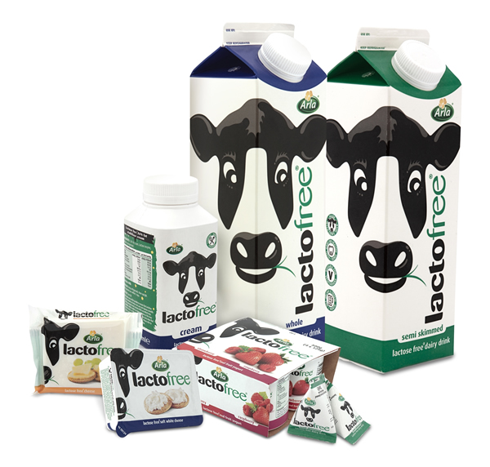
What is Lactose Intolerance?
When the body cannot digest the sugar in cow’s milk (lactose)
Often confused with cow’s milk protein allergy
An intolerance, not an allergy
Very rare
Can be temporary following an upset tummy
Symptoms are very similar to cow’s milk protein allergy:
  Diarrhoea, nausea & occasional vomiting, wind, tummy ache

Slide 10
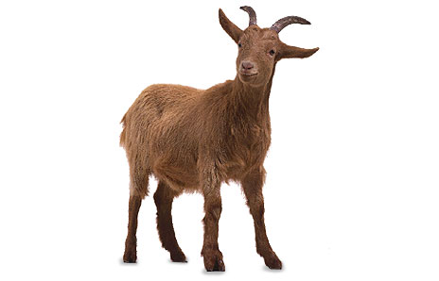
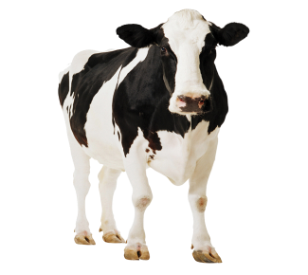

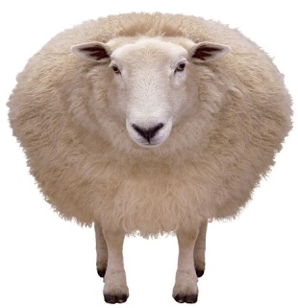
Treatment for Cow’s Milk Protein Allergy
A diet free from cow’s milk and food made with cow’s milk
Also avoid milk and food products from other animals, such as sheep, goat & buffalo as the protein is very similar to the protein in cow’s milk
If under 1 year of age, your child should have breast milk or a suitable extensively hydrolysed or amino acid formula milk as their main milk drink

Slide 11
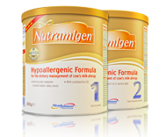
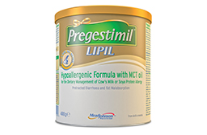
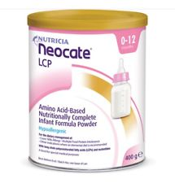
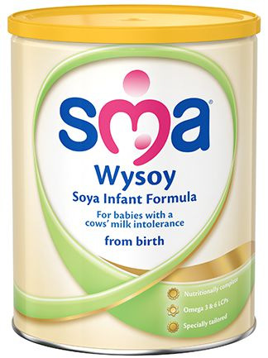
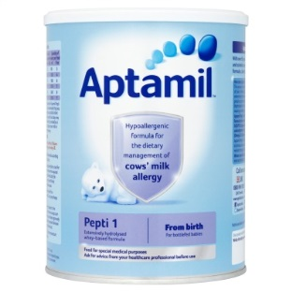
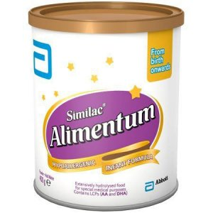
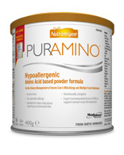
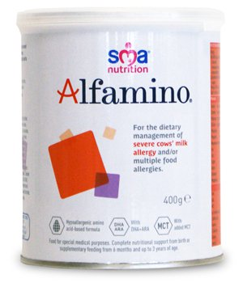
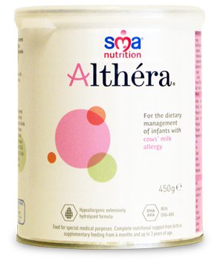
Suitable Formulas for Cow’s Milk Protein Allergy
Extensively Hydrolysed Formulas (eHF)
Amino Acid Formulas
Soya
(Over 6 months)

Slide 12

Food Labelling
To follow a cow’s milk protein free diet, it is important to check food labels:
Pre-packed food
  allergens are emphasised on the label, e.g. skimmed milk powder, hydrolysed casein (Milk), cream (from milk)
Foods without packaging/food served whilst you are out
  written or verbal information on allergens needs to be provided by staff
‘May contain’ warnings
  food may be contaminated with an allergen by accident
The law only covers allergens used as ingredients, not allergens that may be present following accidental contact
For medicines, always check with your pharmacist

Slide 13
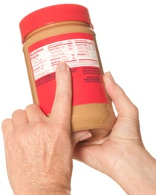
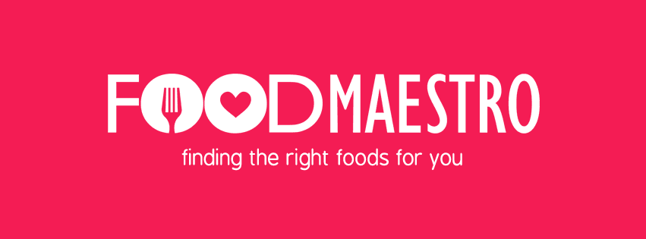
Top Tips
Check ALL food labels – you’ll be surprised by what contains milk!
Ask your local supermarket for a list of their own brand foods which are ‘cow’s milk free’
Don’t assume that a ‘free from’ product will be free from all allergens - always check the label
Online supermarket sites are useful but always check the label of the product
Use the Food Maestro App

Slide 14
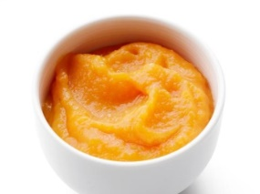

Cow’s Milk Protein Free Weaning
This is the same as weaning a non-allergic baby except you are avoiding foods which contain cow’s milk
Weaning occurs around 6 months
Stage 1
Try mashed or pureed fruit and vegetables like parsnip, potato, yam, sweet potato, carrot, apple or pear
Baby rice or porridge (remember to check food labels)
Use baby’s usual milk (breast milk or hypoallergenic formula) to mix food to desired consistency
Pureed/mashed meat, chicken or lentils

Slide 15
Stages 2 & 3 – Meal Ideas
Breakfast
  Cow’s milk free breakfast cereal/porridge with milk substitute
  Toast fingers with cow’s milk protein free spread
  Pancakes made with milk substitute
Main meals
  Baked beans or scrambled egg on toast
  Meat/chicken or fish with potato/rice and vegetables
  Pasta with a tomato, roasted vegetable sauce or cow’s milk free white sauce. Can add cow’s milk free cheese.
  Flaked fish poached in a milk substitute, mashed potato & vegetables
  Shepherd’s Pie using cow’s milk free substitutes
  Omelette using soya milk & cheese alternative
Check the food labels

Slide 16
Puddings
  Fruit
  Cow’s milk free yoghurts, desserts, ice cream, custard (serve with fruit)
  Rice pudding, semolina or custard made with milk alternative
  Milk jelly using milk alternatives
Finger food/snacks
  Raw vegetable sticks
  Dried fruit/small pieces of soft, ripe fruit
  Cow’s milk free cheese cubes/slices
  Breadsticks or hummus
  Crumpets/bagels/pittas/cheese scone made with cheese alternative
  Sandwiches with egg/tuna/chicken/ham/cow’s milk free cheese spread
Check the food labels

Slide 17
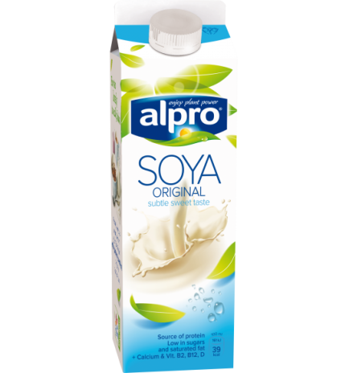
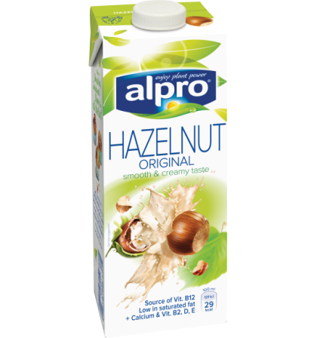
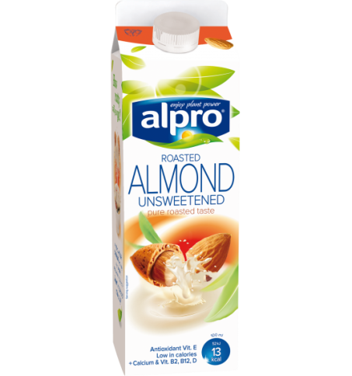
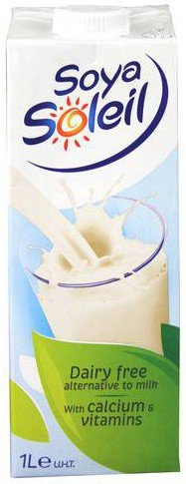
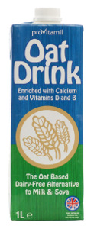
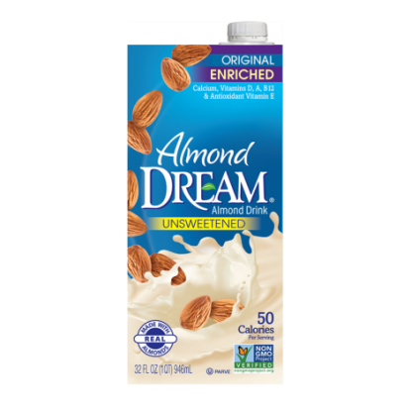

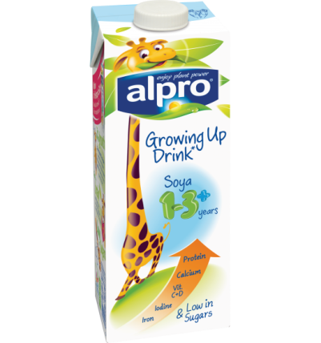
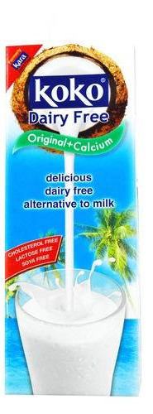
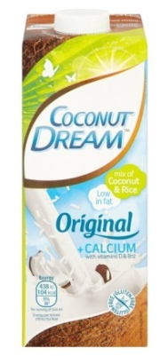
Suitable Alternative Milks
Can be used in cooking over 6 months of age
Generally not to be used as main milk drink until your child is 1 years of age
Choose a milk with added calcium
Soya Milk
Hazelnut Milk
Oat Milk
Almond Milk
Alpro Soya Growing Up Milk
(can be used as main milk drink from 1 year)
Coconut Milk

Slide 18
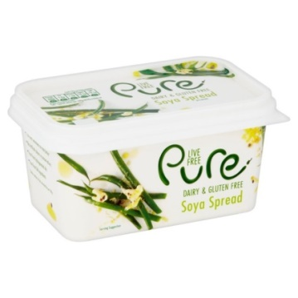
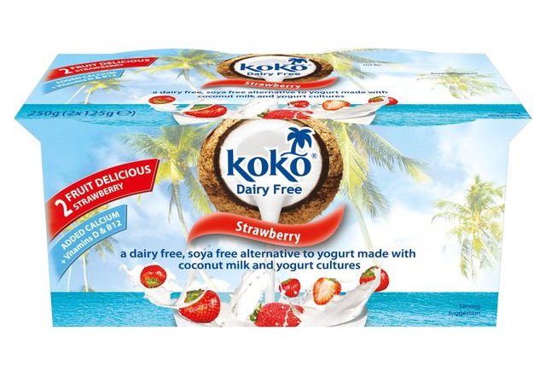
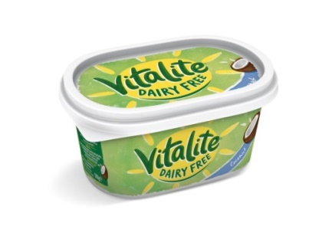
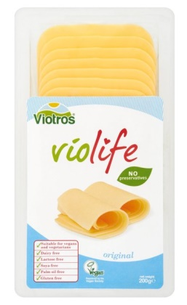
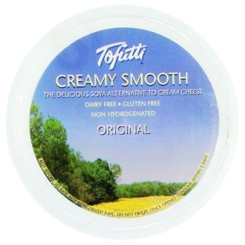
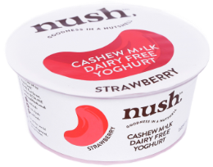



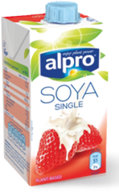
Other Cow’s Milk Free Alternative Products
Spreads
Cheese
Yoghurts & desserts
Ice creams & frozen desserts
Creams/Custards/Crème Fraiche
Chocolate

Slide 19
Introduction Of Other Common Allergenic Foods
Includes:
  egg, soya, wheat, peanuts and other nuts, sesame seeds, mustard seed, celery, fish and shellfish
Do not usually need to be avoided once your baby is 6 months old
Introduce by giving one new food at a time to help identify any foods your baby may react to

Slide 20
Meeting Calcium Requirements
Important to ensure that your child is receiving enough calcium when following a cow’s milk protein free diet
Breastfeeding mums who are following a cow’s milk protein free diet may need a calcium supplement
Calcium requirements change with age
Use foods fortified with calcium to help meet requirements, e.g. cow’s milk protein alternatives

Slide 21
Vitamins for Children
The government recommends:
ALL children aged 6 months to 5 years are given vitamin supplements containing vitamins A, C & D
Babies who are breastfed are given a daily vitamin D supplement from birth
Babies who are formula fed, who are getting more than 500ml (about a pint) of formula per day do not need extra vitamins

Slide 22
Will My Child Grow Out Of Their Cow’s Milk Protein Allergy?
Some children with mild to moderate non-IgE mediated cow’s milk protein allergy will grow out of it by their first birthday
Most children will grow out of their allergy between 1 and 3 years of age
Some may take longer than this or may not grow out of it

Slide 23
Reintroducing cows milk protein?
Home reintroduction is performed in children with non Ig E cows milk protein allergy provided:
  There is no history of immediate or severe reactions to cows milk protein
  There is no current severe atopic eczema

Slide 24
Reintroducing Cow’s Milk Protein
Milk (containing cow’s protein) can be reintroduced into the diet at 9-12 months of age OR 6 months after starting a cow’s milk free diet
Use the Milk Ladder
  Ensure your child is well before commencing
  Begin at step 1 and consume the amount of food suggested
  If the food is tolerated, continue giving your child this food and then try the next step and so on…
  If the food is not tolerated, stop and try again with this step in 4 weeks. Continue to keep any milk containing food that was tolerated in the diet

Slide 25

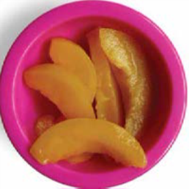
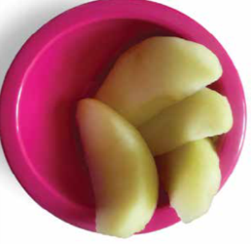
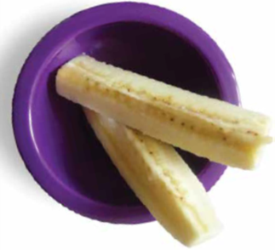
Who else is there to help me?
Your Health Visitor – They can share information on signs of readiness, tips for preparing food, portion size, Baby Led Weaning as well as spoon feeding
To contact your health visitor ring 0300 247 0040 or pop to one of their Well Baby Clinics
online resources
www.firststepsnutrition.org
www.nhs.uk/start4life/weaning

Slide 26


Support for Breastfeeding
Contact your Health Visitor
0300 247 0040
Call National Helpline
0300 100 0212
Chat to Peer Support FAB
Visit on line or Telephone for support and groups
01254 772929
https://www.familiesandbabies.org.uk/pages/central-lancashire
To find on line resources including videos and leaflets https://elht.nhs.uk/services/infant-feeding

Slide 27









Useful Links
For support
Allergy UK www.allergyuk.org
NHS Choices www.nhs.uk
British Dietetic Association www.bda.org.uk
Food Maestro App – free from the App store
For recipes (cooking with cow’s milk free alternatives)
www.oatly.com
www.alpro.com
www.kokodairyfree.com
www.provamel.com
www.tofutti.com
www.violifefoods.com

